Slide 1
Power App Types

Slide 2
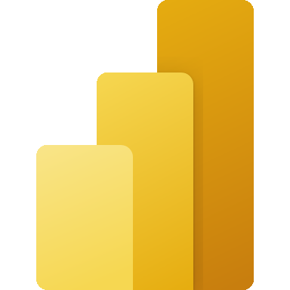
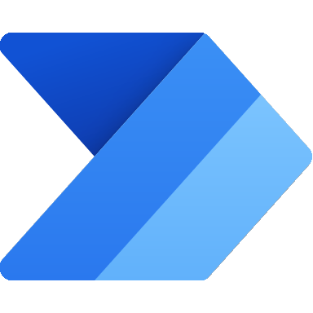
Microsoft Power Platform
One low-code platform that spans Microsoft 365, Dynamics 365, Azure and standalone applications
Power BI
Business analytics
Power Apps
Application development
Power Automate
Workflow automation
Power Virtual Agents
Intelligent virtual agents
Microsoft Dataverse
Data connectors
AI Builder

Slide 3
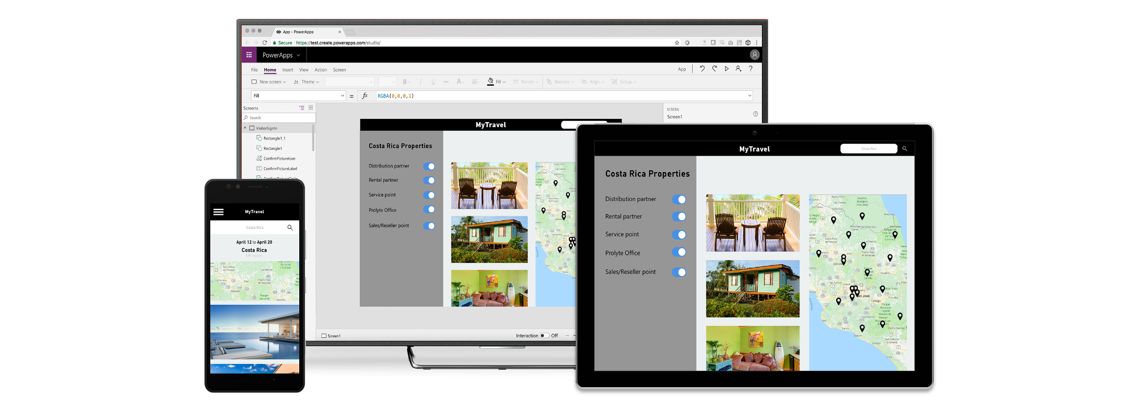
Build apps for web and mobile with Power Apps
Easily build web & mobile apps with a full featured low-code/no-code development experience.
Empower business users to solve their own problems and easily share apps while maintaining security & governance.
Publish instantly to iOS, Android, Windows, and the web.
Sharing apps is like sharing documents.
Manage across environments.

Slide 4
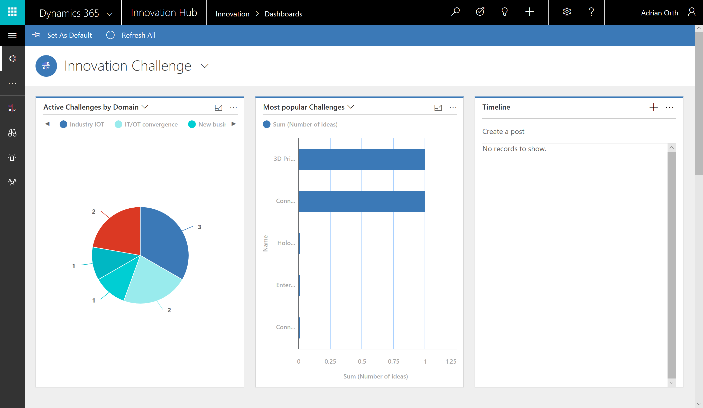
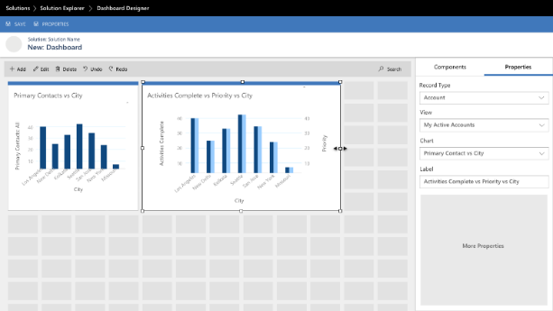
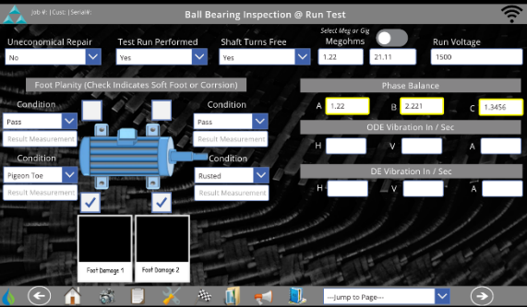
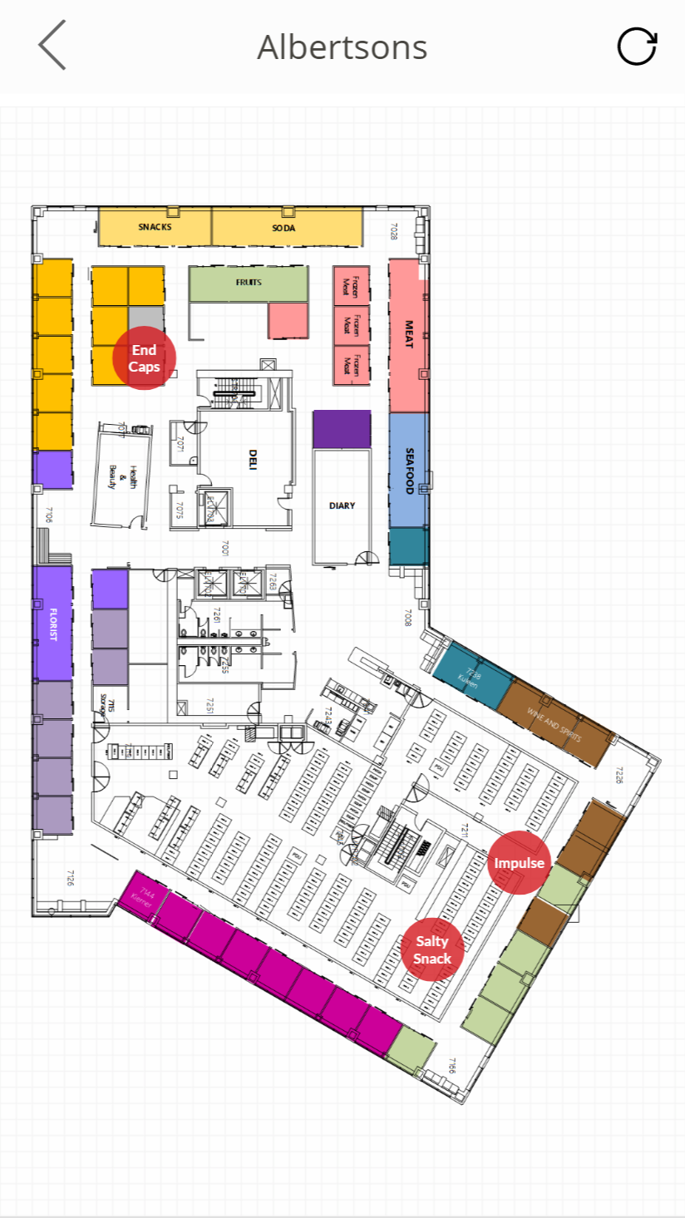
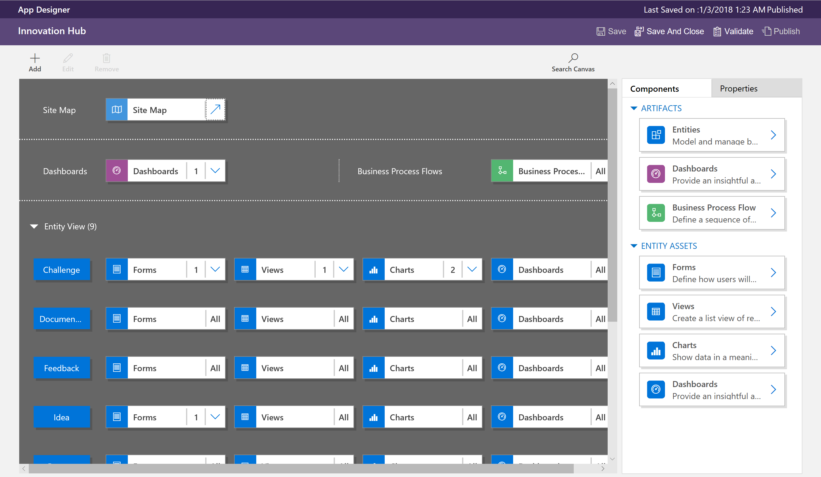
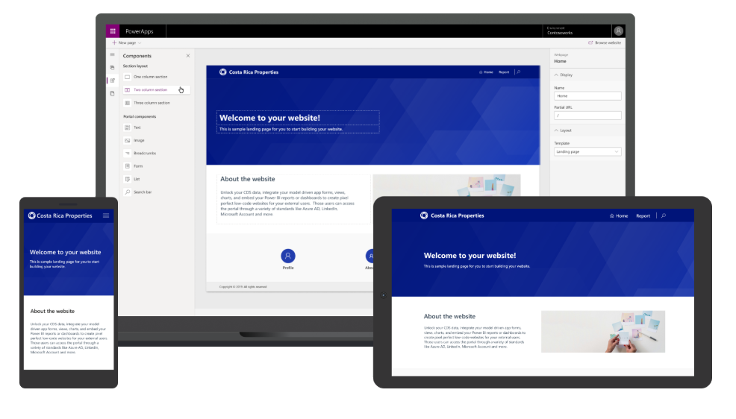
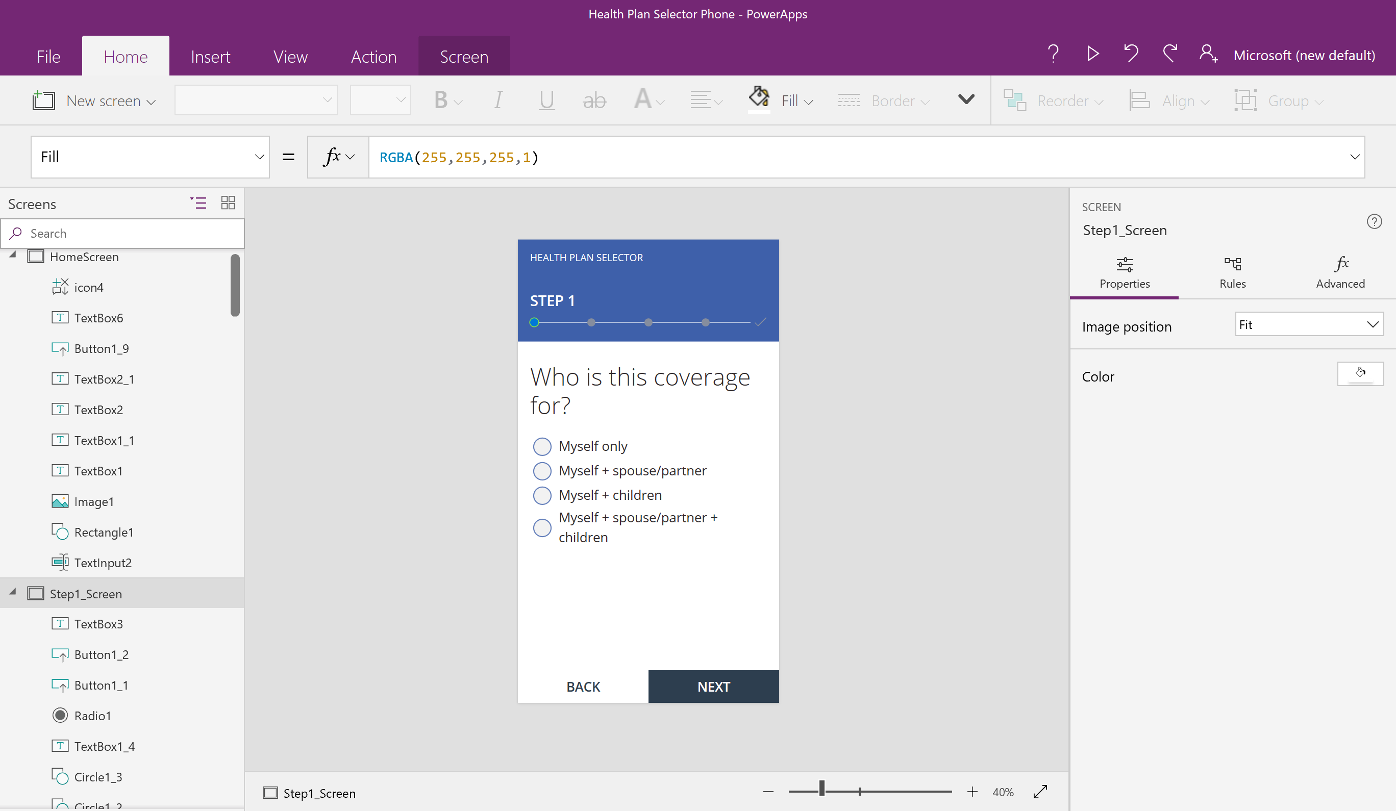
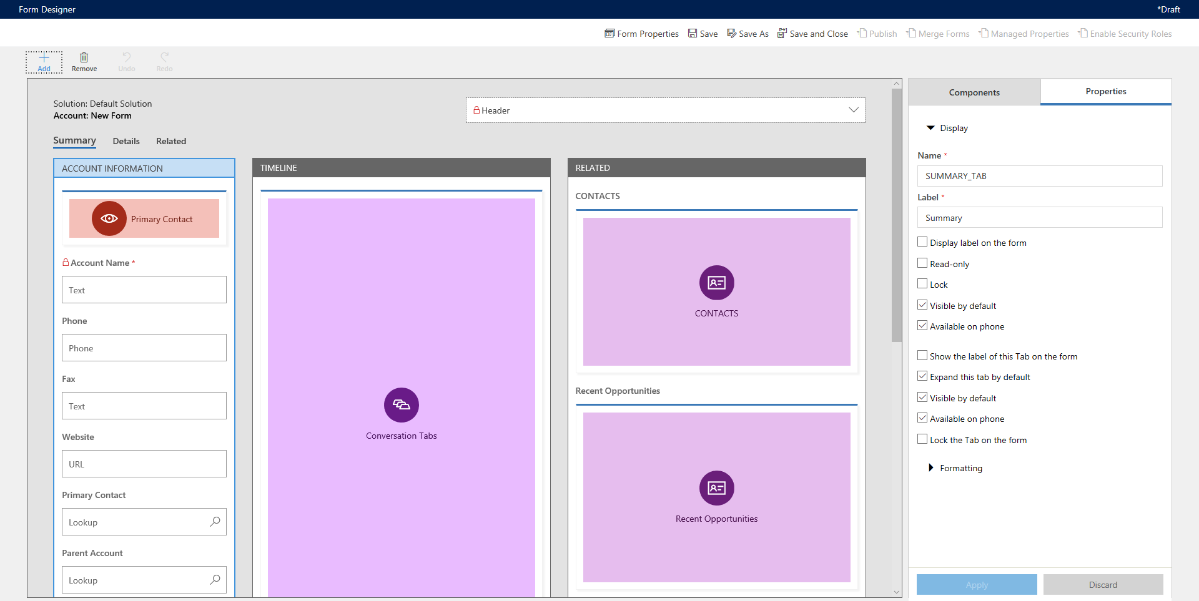
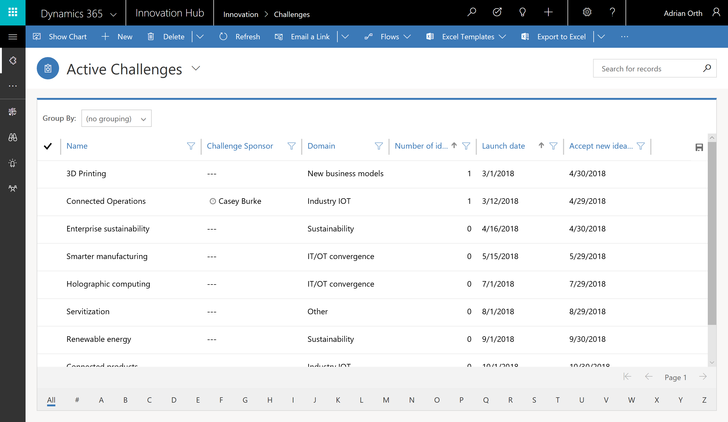
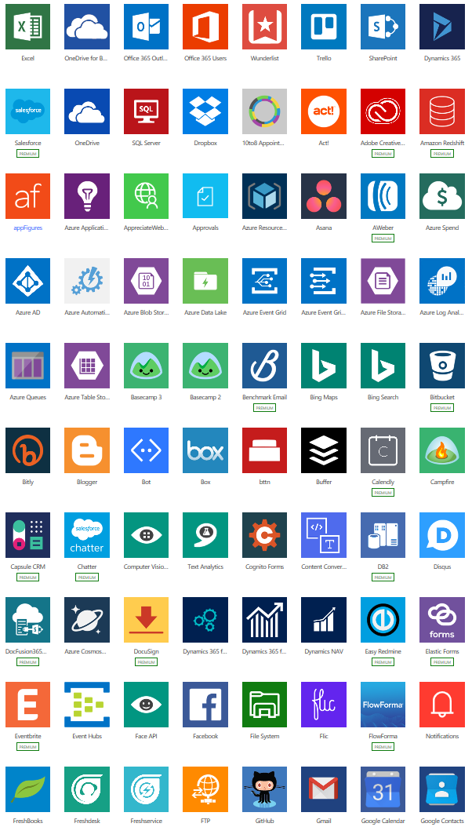
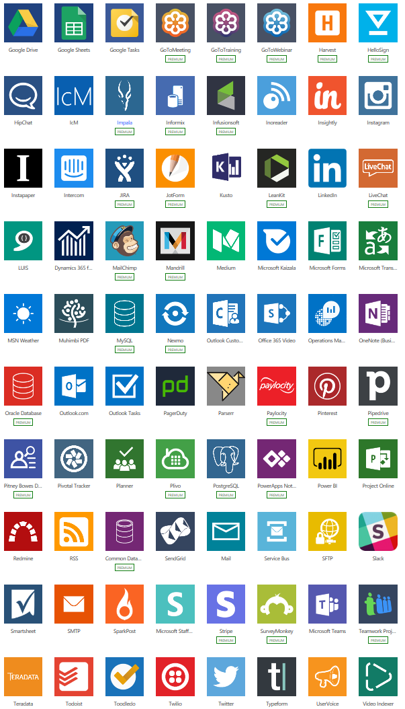
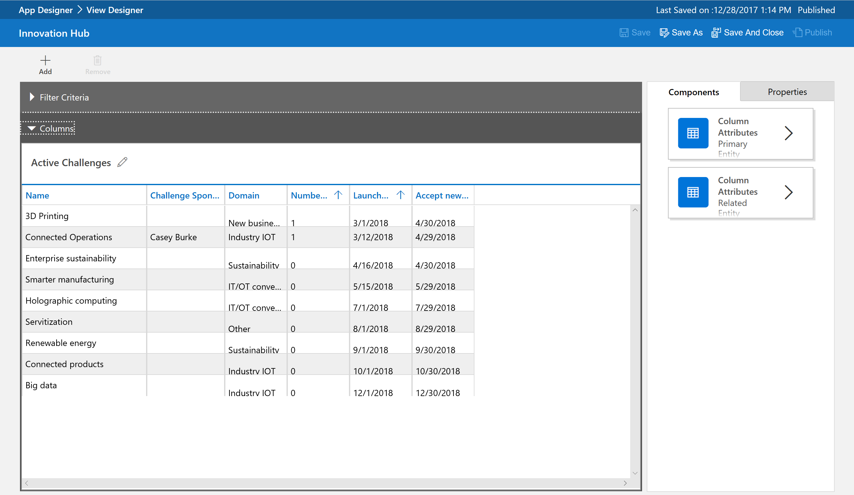
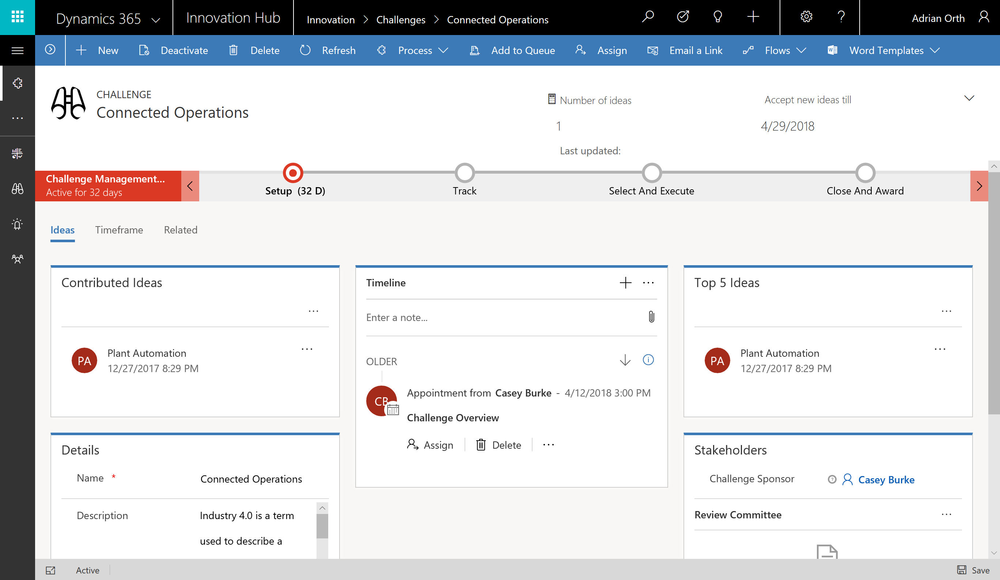
Types of Power Apps
Canvas Apps
Start with user experience in mind.
Build Pixel Perfect Apps, full control over the App Design.
Build Task-based & role-based apps.
Mash-up data from 600+ data sources.
Model-driven Apps
Built on Microsoft Dataverse.
Start with a data model, build relationships and business processes.
Build End-to-End business applications.
Build Immersive and responsive applications.
Power Apps Portals
Web based apps that allow internal and external access to view and update data within Dataverse.
Build websites with anonymous access.
Microsoft Dataverse based.

Slide 5
Canvas Apps
Canvas Apps

Slide 6
Canvas Apps help business-power-users to create and use custom business apps across platforms using Excel and PowerPoint skills.
Start with a blank screen and design your app visually by adding components to it.
When you're ready, connect it to data.
Connect to data & systems you’re already using easily
Create apps, forms, and workflows without writing code
Use apps on any device – both web and mobile

Slide 7
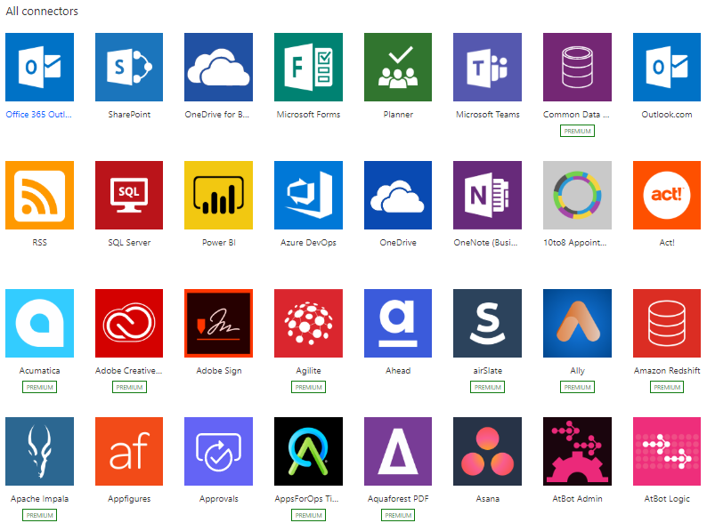
Connectors
Defines how you connect services with Microsoft Power Apps.
Over 600+ connectors available.
Connectors are classified as Standard, Premium & Preview.
Connect to on-premises systems via the Data Gateway.
Create your own - Custom Connectors.
Licensing is based on Connectors used in App.

Slide 8
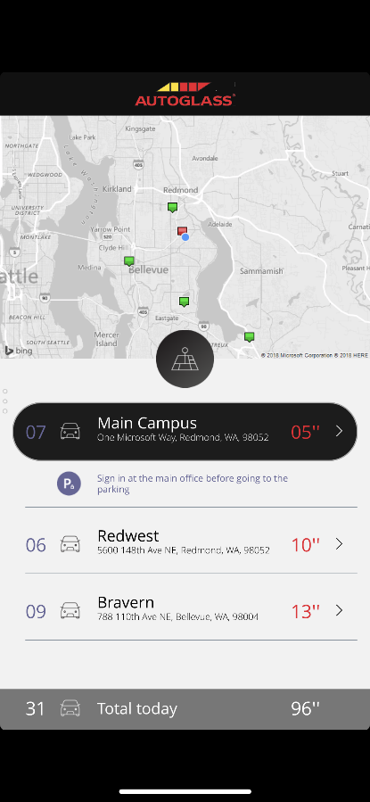
Anatomy of a Canvas app
WYSIWYG design experience
PowerPoint like pixel perfect drag and drop design experience. Start from a template, app is running with live data as you build it
Any platform support
Supports all major platforms and gives native access to device capabilities like camera, GPS, pen & ink
Data connectivity
Connect to hundreds of services and apps with built-in connectors. Over 500+ connectors available.
Share apps like documents
Share your app with 3 clicks and an email address. It’s pushed to mobile devices in seconds
Built-in data platform
Use Dataverse to store app data in a standardized Common Data Model
Seamless integration
Directly integrated with Power Automate, Power BI, Microsoft Teams, Office 365, Dynamics 365 & Azure
App logic
If you can understand formulas in Excel, you can add logic to your Power App.
Leverage AI Builder to democratize AI in your org
Extensibility model
No limits. Get a pro-dev to build you a control or connector if you need something custom

Slide 9
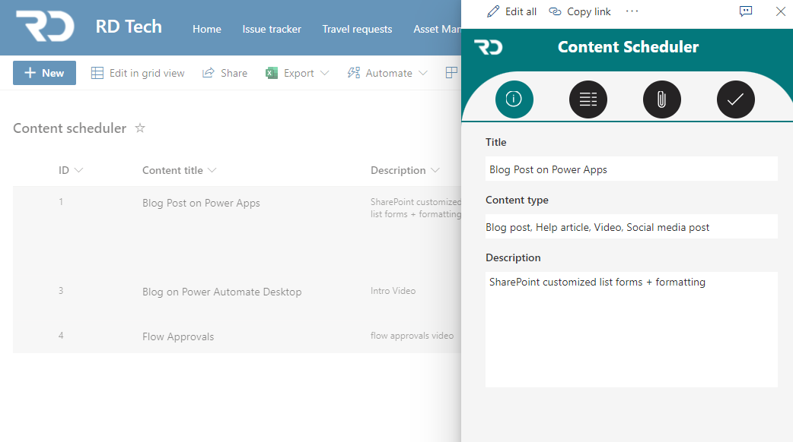
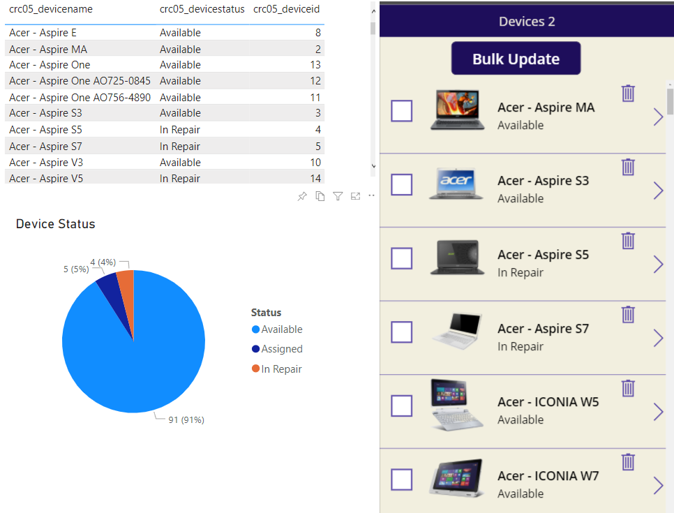
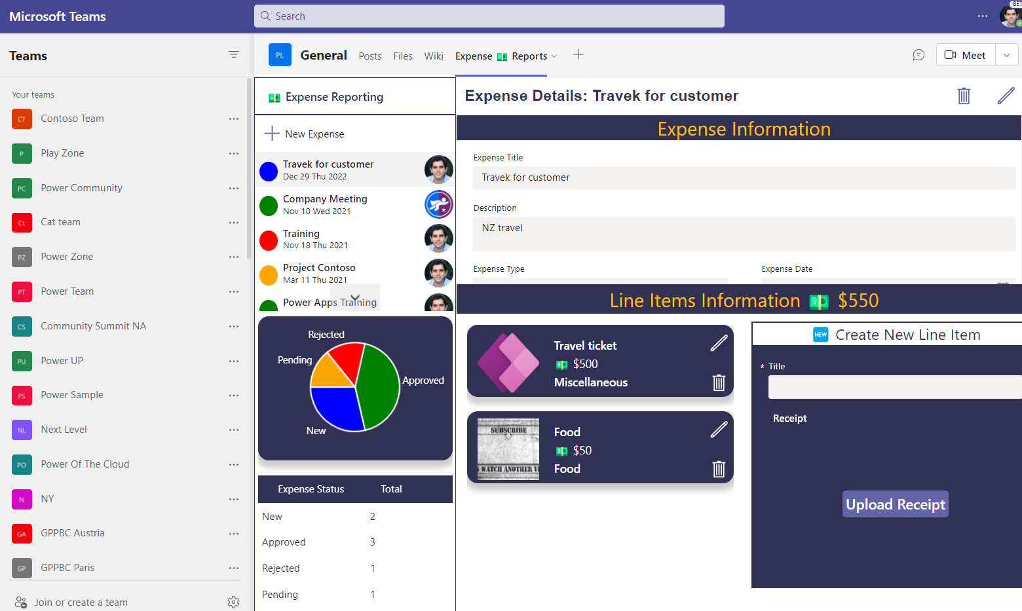
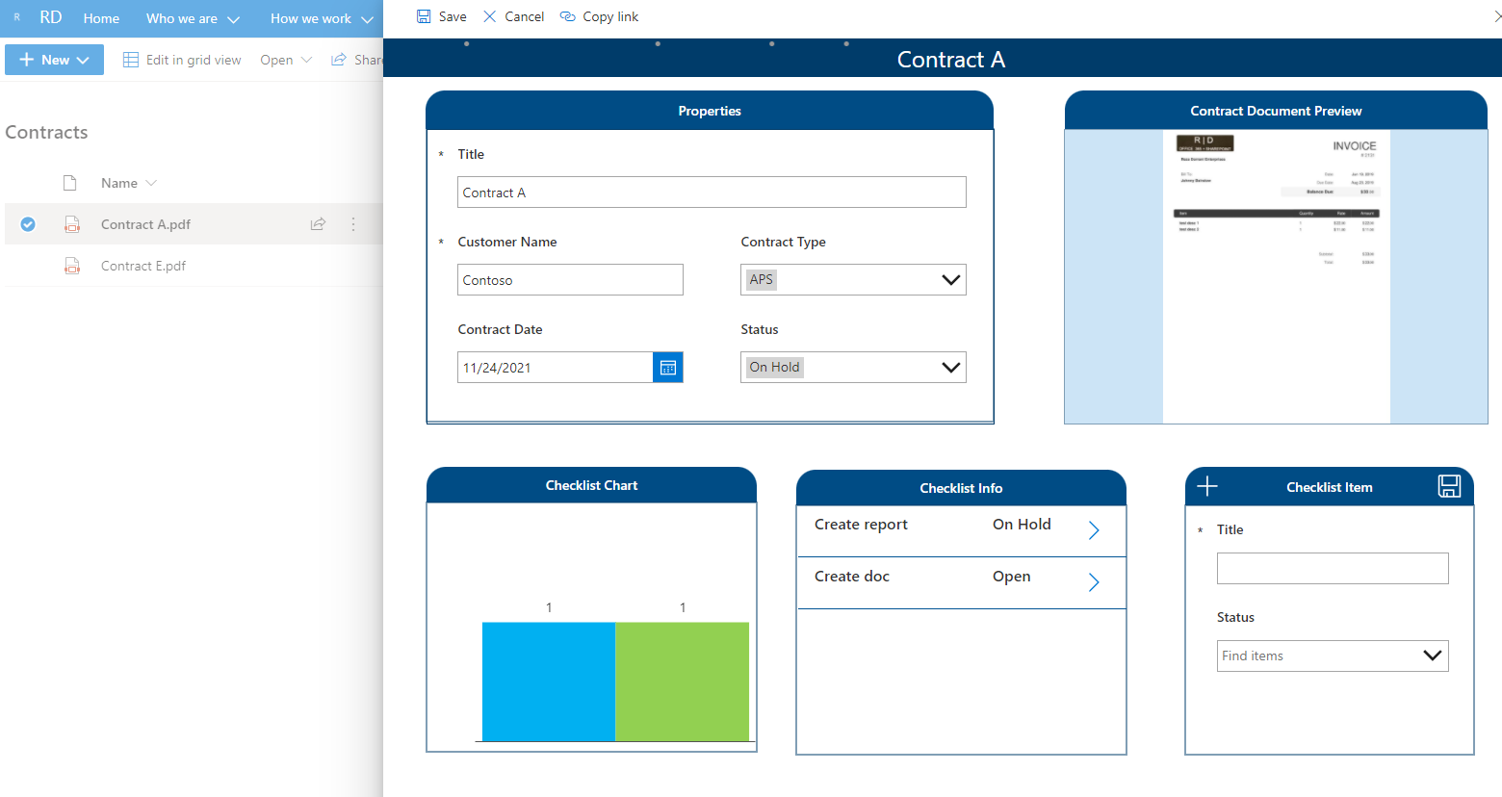
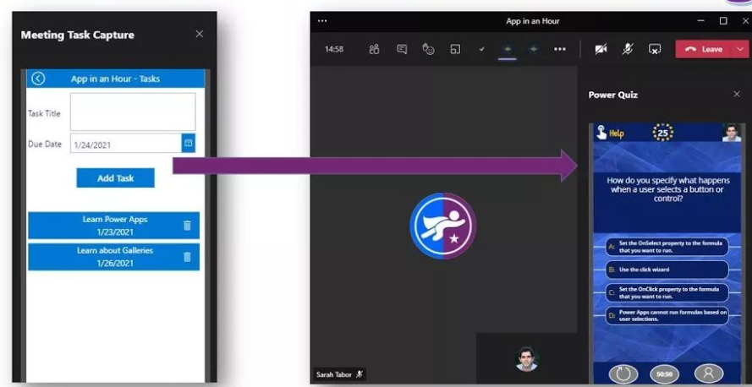
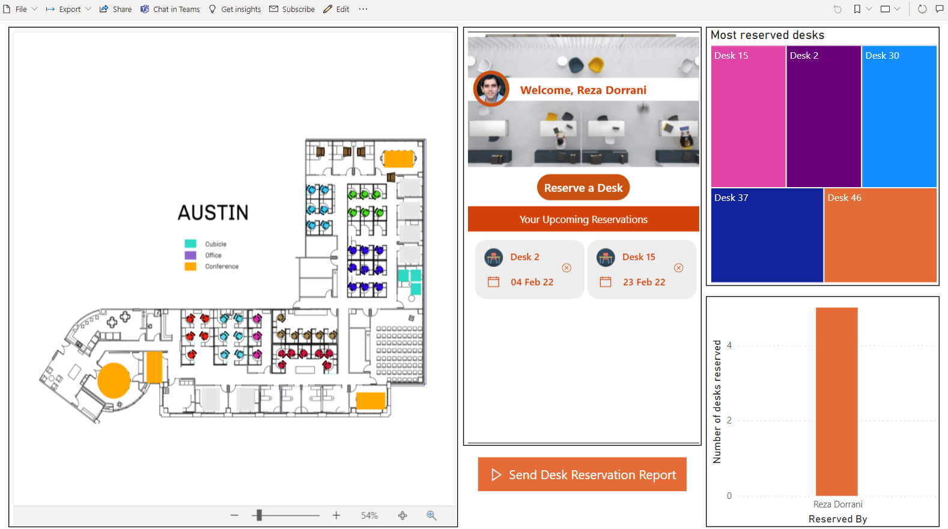
Canvas App Flavors
Standalone Canvas Apps
Power Apps Mobile App.
Build Responsive Apps using containers.
make.powerapps.com
License is based upon connectors used.
SharePoint customized list forms via Power Apps
No more InfoPath please!!!
Customize list/library forms.
Connect to other lists & data sources.
Not Responsive.
Dataverse for Teams Apps
Runs in Teams context only.
Built in Teams.
Dataverse for Teams standard feature (2GB database limit).
Build Responsive Apps using containers.
Power BI Connected Apps
App gets data from Power BI data set.
App can refresh Power BI Visuals (Direct Query)
App license needed (based on connector).

Slide 10
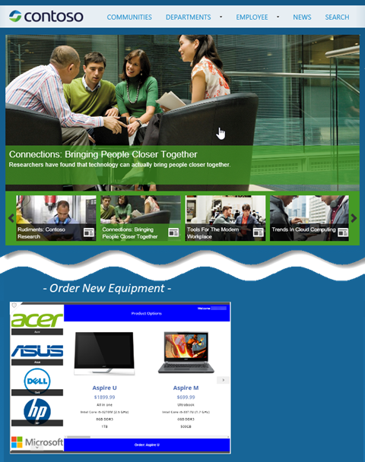
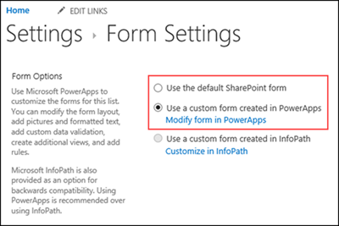
Canvas Apps Better together!
Canvas Apps Integration in:
In SharePoint (Customized List Forms & SharePoint web part)
In Power BI (connected App)
In Microsoft Teams (Tab, Meetings)
In Microsoft Search (Play Inline)
In Model-driven Apps (Custom Pages & Embedded Canvas Apps)

Slide 11
When to start with Canvas Apps
Low Code (Excel & PowerPoint Skills)
Build Pixel Perfect Apps, full control over the App Design.
Build Task-based & role-based apps.
Mix & Mash-up data from 600+ data sources (integrate with data sources).
Rich integration features (SharePoint, SQL, Power Automate, Power BI, etc.)
Native Mobile Capabilities (Camera, Location etc.)
Licensing (If standard connectors are used)
Data source is not Dataverse. (If you are already invested in other data sources e.g. SharePoint, SQL)

Slide 12
Demo – Canvas Apps

Slide 13
Model-driven Apps

Slide 14
Model-driven Apps
Component focused approach to App development without writing code.
Built on Microsoft Dataverse as the data model, manage relationships, and business processes, build end-to-end business applications, immersive and responsive applications.
Rich component-focused no-code design environments
Easily add Business rules and Business process flows to model your business processes
Complex responsive apps on web and mobile

Slide 15
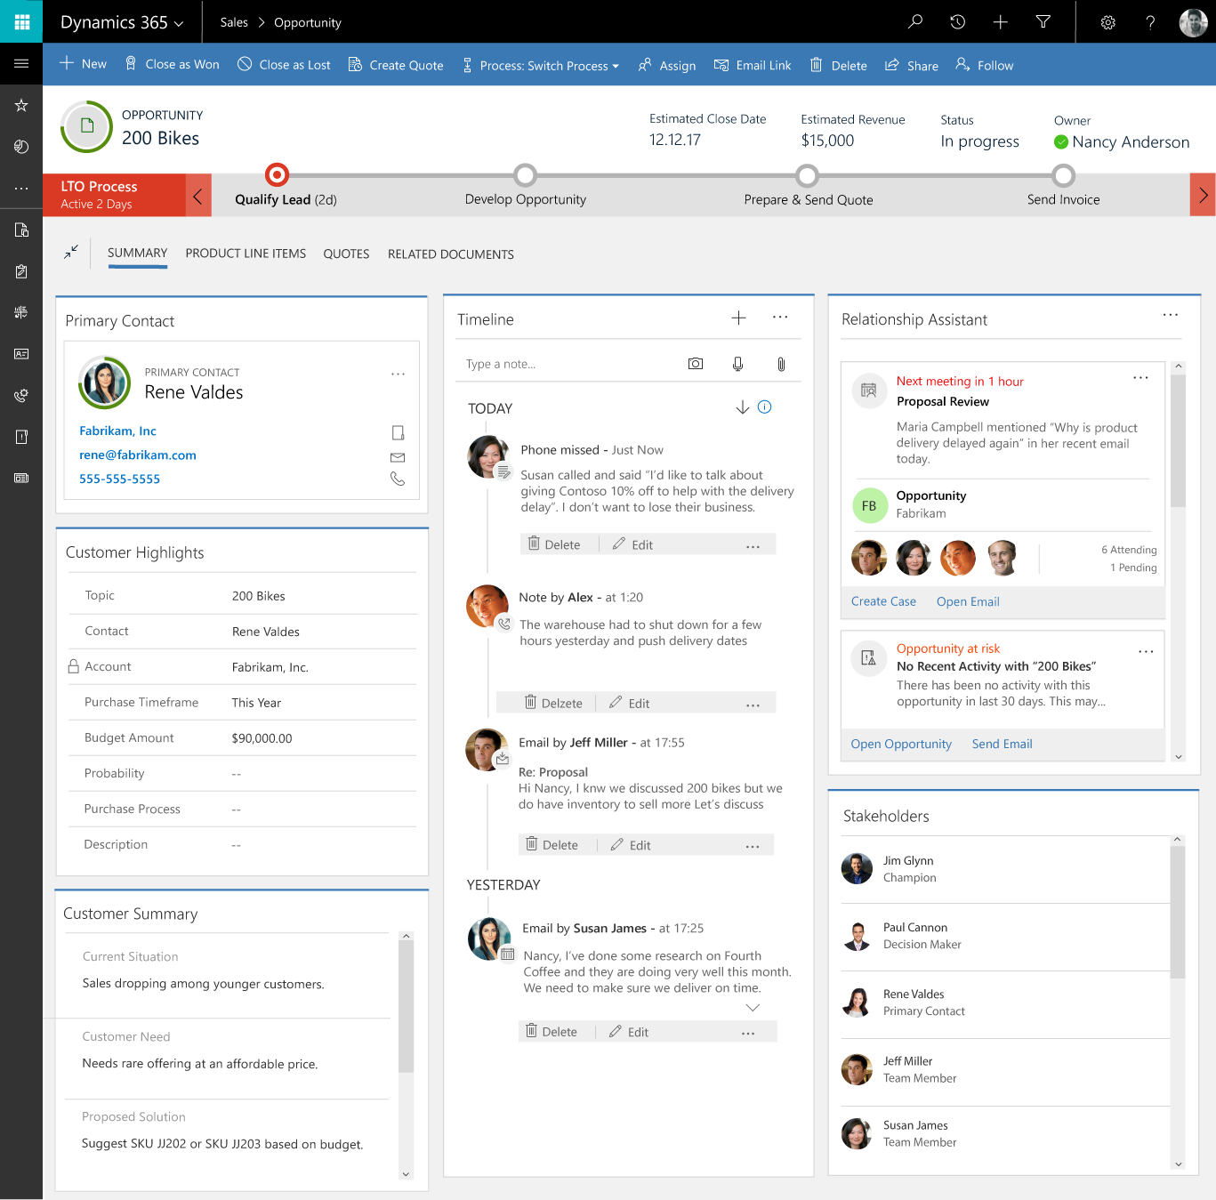
Component-focused approach to app development
Create apps around forms and processes.
Design sophisticated entity forms quickly.
Drag and drop fields and controls in a visual designer.
Forms can span multiple columns, multiple steps, and collapsible sections.
Rich, responsive client experiences.
Easily share forms, dashboards, flows, and more across multiple apps.

Slide 16
Component-focused approach to app development
Create apps around forms and processes.
Design sophisticated entity forms quickly.
Drag and drop fields and controls in a visual designer.
Forms can span multiple columns, multiple steps, and collapsible sections.
Rich, responsive client experiences.
Easily share forms, dashboards, flows, and more across multiple apps.

Slide 17
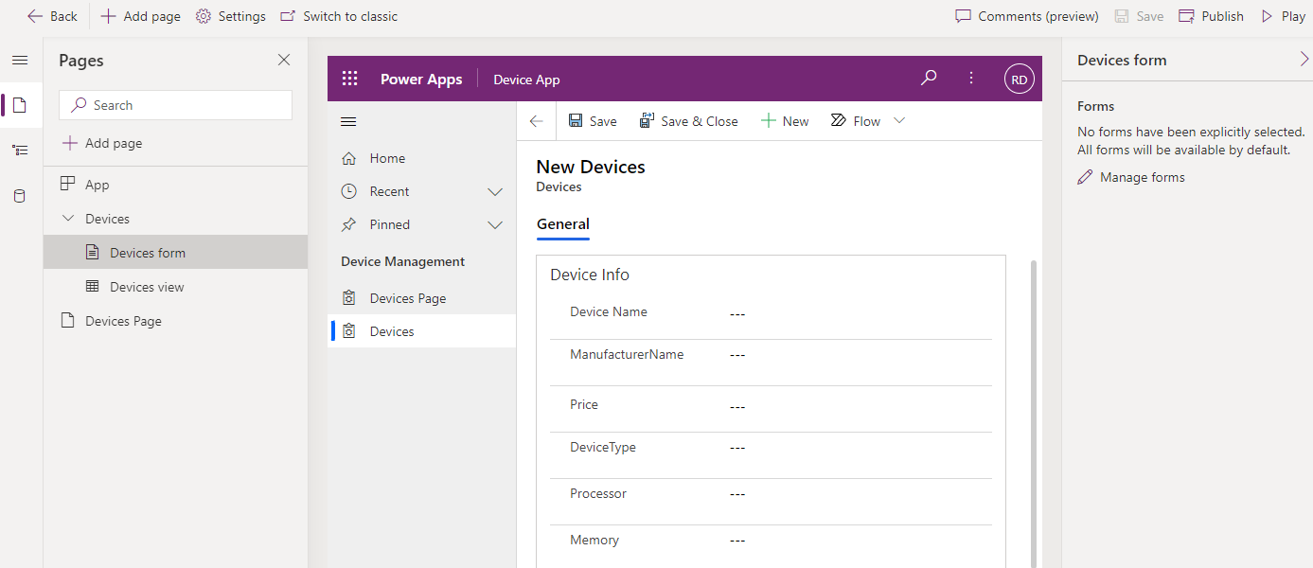
App Designer
Build Model-driven Apps with the App designer.
Add items to your app and sitemap.
Build robust, powerful grids and forms on top of Dataverse, and preview your app changes directly in the authoring experience.
Connect to multiple Dataverse Tables.
Define the App Navigation Bar.
Add Custom Pages.
Customize the Command Bar.

Slide 18
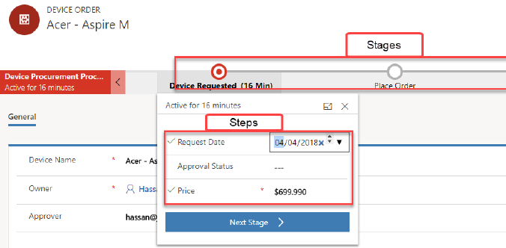
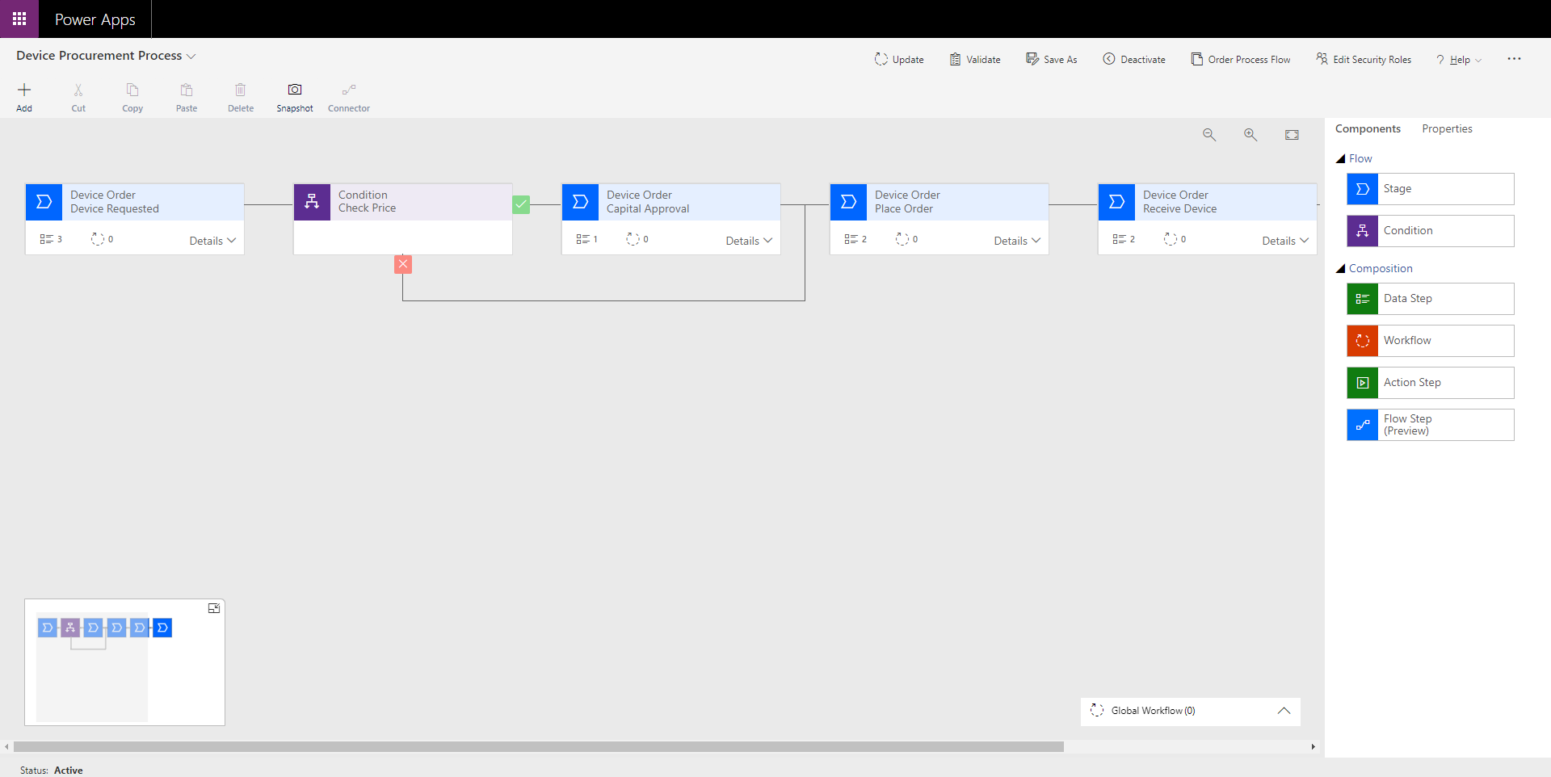
Business Process flows
Create stages or screens that enforce a certain sequence of steps.
For each stage, collect data from the user and kick off automated workflows.
Create branching logic based on data.
Visual indicators that tell users where they are in the business process.
Reduce the need for training .
Notes:
Examples:
Onboarding and training new employees
Nurturing sales leads and closing the loop on opportunities

Slide 19
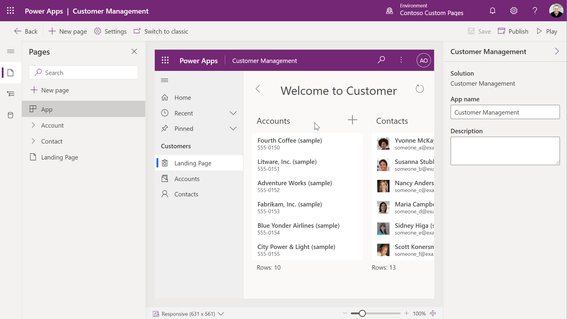
Custom Pages in Model-driven Apps
Better together: introducing Custom Pages and the Modern App Designer.
This does not change the support for the stand-alone canvas app but enables the new Power App converging model and canvas.
A custom page can be used in places where all pages are supported including main area, dialogs, and the new app side pane.
Build pixel perfect landing page with data pulled from across the organization.
Custom pages can open other custom pages or model pages.

Slide 20
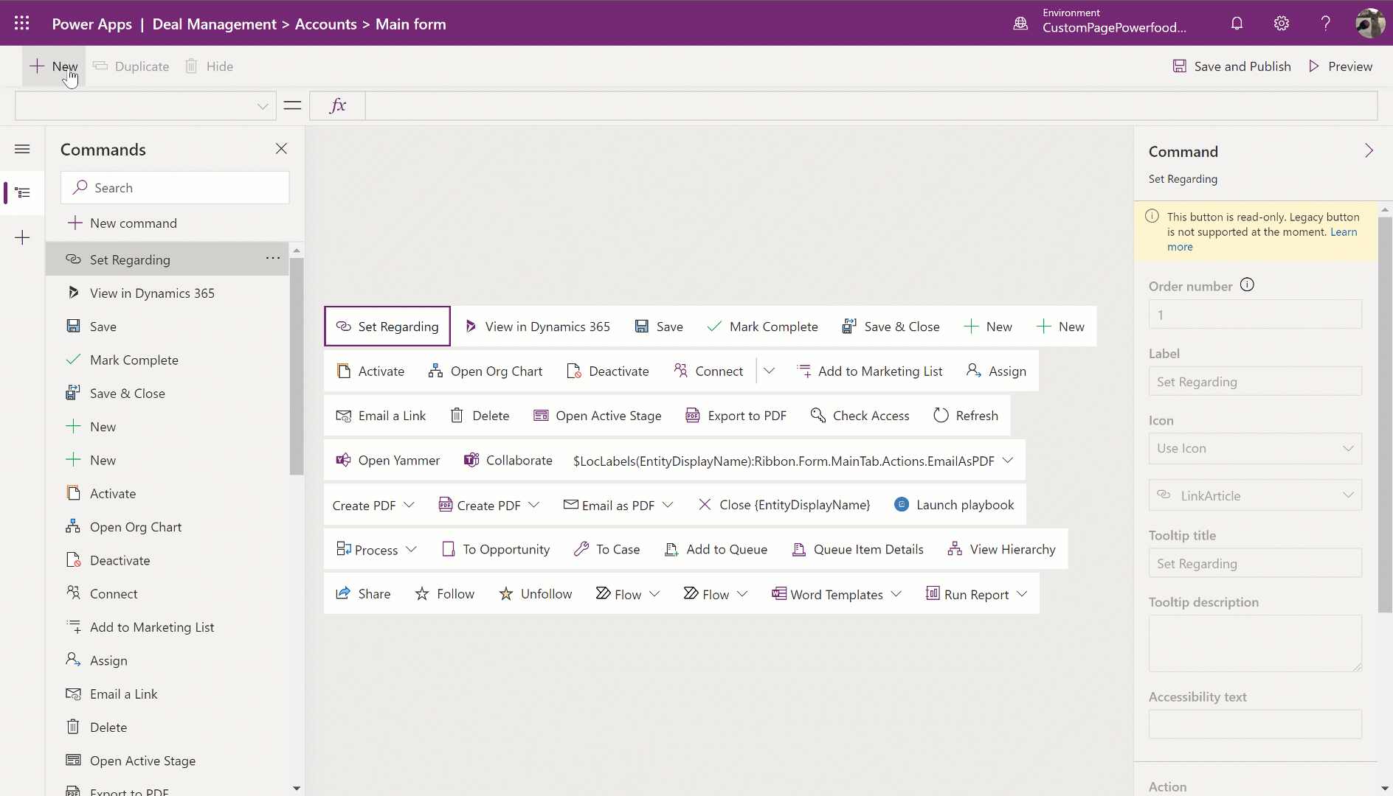
Command Designer
Customize command bars in model-driven apps without code.
Open a Custom page as a dialog.
Power Fx support for visibility and action logic.
Use JavaScript for more advanced logic.
Commands are applied to individual apps.
Classic commands remain supported, Apps can run both classic + modern commands side by side.

Slide 21
When to start with Model-Driven Apps
No-Code
Leverages Dataverse - Same database that Dynamics 365 is built on.
Component focused approach with Relationship driven architecture.
Focus on the data model.
Responsive by design.
App adapts to changes in data model & security.
Leverage Business Process flows, Business Rules, Forms , Views, Charts etc.
Common user tooling functionality (import, export, sort, filter etc.).
Native Offline Capabilities.
Delegation challenges averted.
Invested in Premium License or Dynamics 365.

Slide 22
Demo – Model-driven Apps

Slide 23
Portals

Slide 24
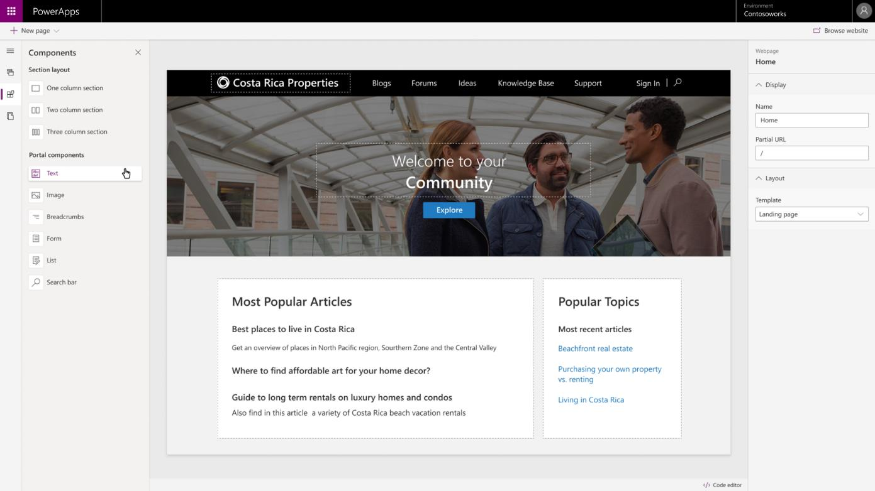
Power Apps Portals
Responsive Websites.
Enable External access with Power Apps portals.
Empower anyone either inside or outside your organization to interact with Microsoft Dataverse data using portals.
Enrich portals with model-driven forms, views, lists, charts, and dashboards

Slide 25
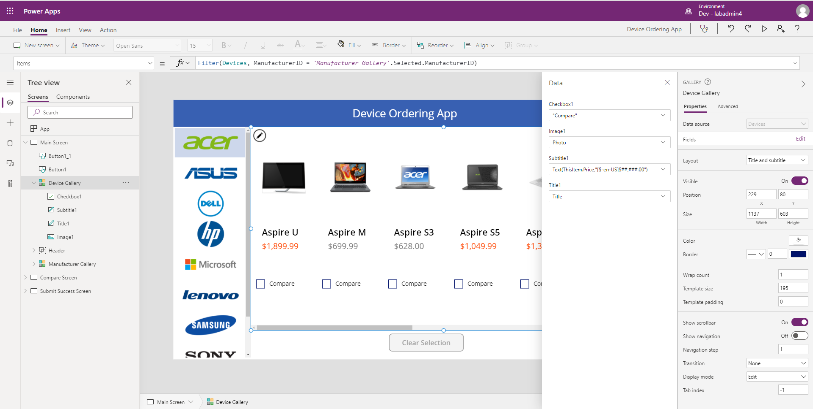
Easy Authoring
Truly WYSIWYG – full control over user experience, use it as you build it
Create app logic with familiar Excel-like expressions
Mash up data from multiple sources right at the app level
Notes:
You can drag and drop controls to wherever you need them, or you can explicitly place them using x and y coordinates. It is up to your personal comfort level building an app.

Slide 26
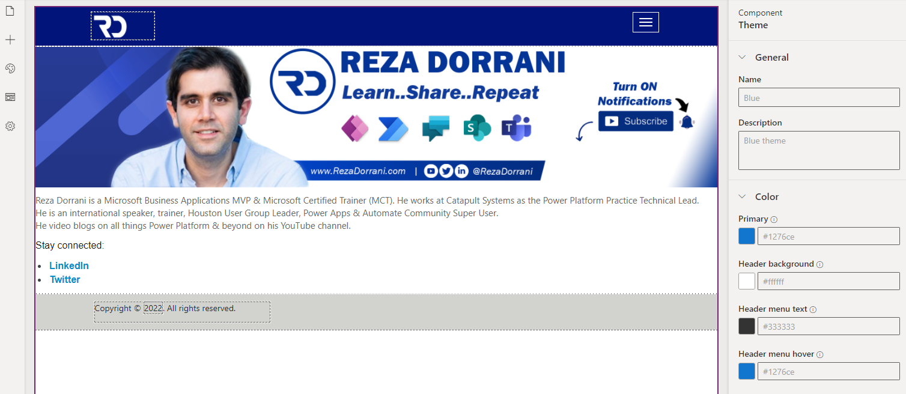
Portal Designer
Command Bar – Create Pages, Add components, sync configuration changes & browse website.
Toolbelt – View & Manage pages, components, set themes etc.
Canvas – Contains components of webpage
Properties Pane – Displays properties of webpage and selected components.

Slide 27
When to use Portals
Responsive Websites
Anonymous & External access to website backed by Microsoft Dataverse
Leverage Dataverse features – Relational Database
Easy to build.
UI Control.

Slide 28
Demo – Portals

Slide 29
Feature Comparison

Slide 30
Feature | Canvas App | Model-driven App | Power Apps Portals | Dataverse for Teams
Relational data structure | Yes* (If connected to a relational database) | Yes | Yes | Yes
Responsive Design | Yes* (Requires work. Use responsive container controls) | Yes | Yes | Yes* (Requires work. Use responsive container controls)
Mobile Native | Yes | Yes | Yes | Yes - Only via Microsoft Teams App
Offline Functionality | Yes* (Very Limited storage capacity) | Yes | No | Yes* (Very Limited storage capacity)
Low Code/Citizen Dev friendly | Low Code (Excel & PowerPoint Skills) | No Code | No Code | Low Code (Excel & PowerPoint Skills)
Time to market? | Medium – depends on complexity of App. | Low | Low | Medium – depends on complexity of App
Licensing Costs | Low – Depends on connectors used. Premium connectors will require App to be premium licensed for all users of App. | Medium – Premium license needed + Storage capacity. | High – Premium license needed + additional license costs for anonymous users (page views etc.) + Storage capacity. | Low – Dataverse for Teams is a standard feature. Premium connectors (if used) will require App to be premium licensed for all users of App
Data Storage capacity | Depends on data source connected in App. | Dataverse only. Unlimited storage with costs. | Dataverse only. Unlimited storage with costs. | Dataverse 2GB max per Team environment. Can be upgraded to full Dataverse.

Slide 31
Feature | Canvas App | Model-driven App | Power Apps Portals | Dataverse for Teams
External Access (authenticated) | Yes (Guests need license) | Yes (Guests need license) | Yes (Guests need license – capacity license) | Yes (Guest users for Teams. No license needed.)
External Access (anonymous) | No | No | Yes | No
Creating "Pixel Perfect" App (Full UI control) | Yes | No* (Custom Pages) | Yes* (limited control) | Yes (fluent controls + Teams theme)
Customization of SharePoint List Forms | Yes | No | No | No
App in Power BI context | Yes | No | No | No
ALM | Yes | Yes | Yes | No* (Single environment)
Delegation (working with large data) | Yes* (Responsibility of App Maker) | Yes | Yes | Yes* (Responsibility of App Maker)
Templates | Yes* (Outdated) | Yes | Yes | Yes (Consume decent amount of capacity)
Security + Sharing | Security must be defined at data source level + App shared with users. | Access to App & Security is via Security Roles in Dataverse | Access & Security is via Security Roles in Dataverse | App is available for Teams members, owners, guest users & colleagues. Security is defined at Table level.

Slide 32
Thank You

